Slide 1
Fundamentals of Electric Transmission System Planning
Talk 8: Electric Grid Dynamics and Stability
Prof. Tom Overbye
Dept. of Electrical and Computer Engineering
Texas A&M University
overbye@tamu.edu

Slide 2
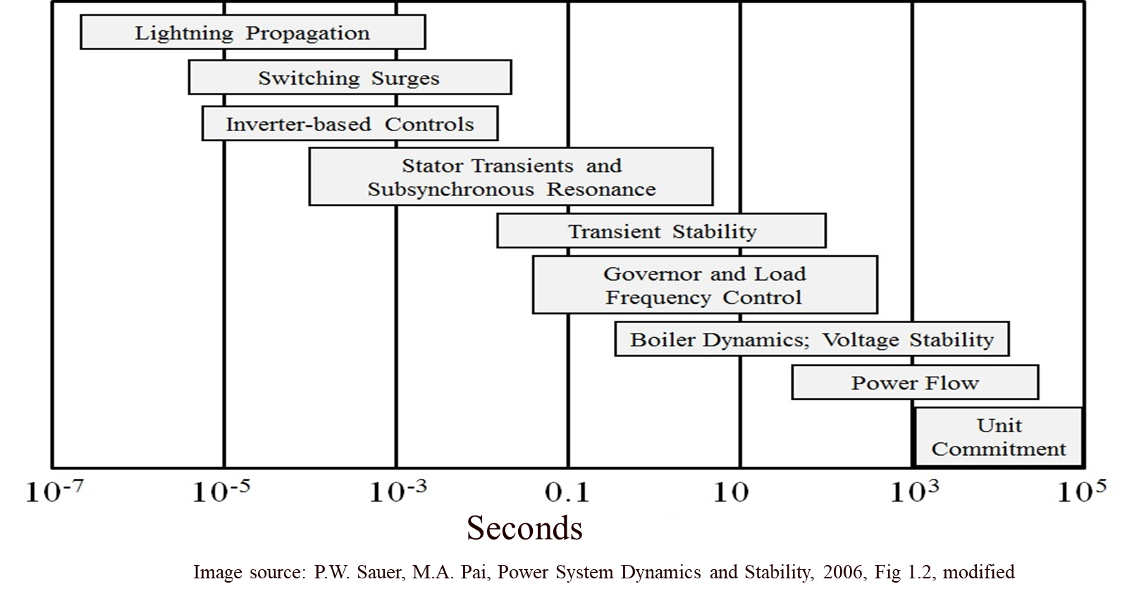
Overview
The focus of this talk is on power system dynamics, with a focus on time frames shorter than steady-state (power flow)
Our focus will mostly be here

Slide 3
A Few Definitions
The words model or modeling have lots of definitions. A germane one is
"Modeling and simulation (M&S) is the use of a physical or logical representation of a given system to generate data and help determine decisions or make predictions about the system.”
Modeling is crucial for power system dynamics and stability since we can’t (easily) physically build the system being considered
Dynamics also has several definitions, with a common one “the study of how moving objects behave” (here the “moving objects” includes electrical values
Likewise Stability has several definitions, with a germane one here is “the property of a body (or system) that causes it to return to its original condition when disturbed.”

Slide 4
Modeling Cautions!
"All models are wrong, but some are useful," George Box, Empirical Model-Building and Response Surfaces, (1987, p. 424)
Models are an approximation to reality, not reality, so they always have some degree of approximation
Box went on to say that the practical question is how wrong to they have to be to not be useful
A good part of engineering is deciding what is the appropriate level of modeling, and knowing under what conditions the model will fail
Always keep in mind what problem you are trying to solve!

Slide 5

A Few Definitions, cont.
An equilibrium point (ep) of a dynamic systems is a point in which the system doesn’t change with time
Large-scale electric grids are never really at an equilibrium point because something is always changing with time. Here we can talk about a quasi-static ep, which is how the system would appear on the power flow time frame
This is what you would observe if you went into a control room and looked at the displays; usually things would appear to be pretty constant
Image Source: why.org from 3/17/20 of PJM control room

Slide 6
Slow versus Fast Dynamics
Key analysis question in setting up and solving models is to determine the time frame of interest
Values that change slowing (relative to the time frame of interest) can be assumed as constant
Power flow example is the load real and reactive values are assumed constant (sometimes voltage dependence is included)
Values that change quickly (relative to the time frame of interest) can be assumed to be algebraic
A generator's terminal voltage in power flow is an algebraic constraint, but not in transient stability
In power flow and transient stability the network power balance equations are assumed algebraic

Slide 7
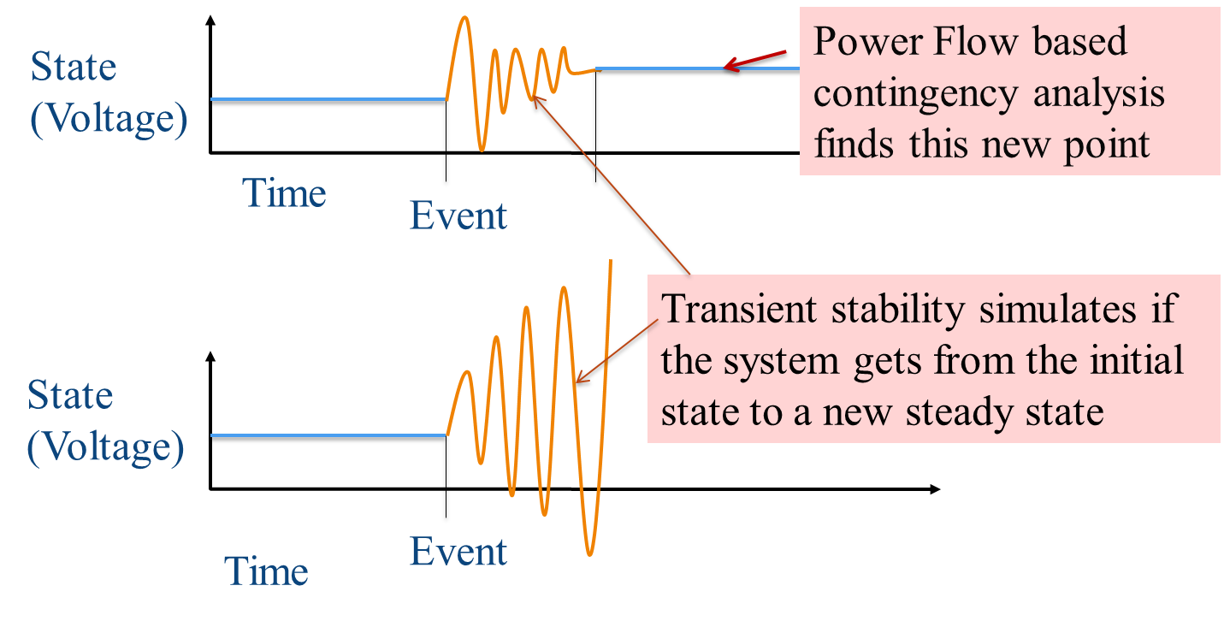
Contingencies
Contingencies (or sometimes known as events) perturb (kick) the system operating point away from its equilibrium point; power system stability analysis looks at whether the system returns to a new equilibrium point
Best case is a new ep exists and the system is able to reach this new ep.
However, a new ep may exist, but the system can’t get there
Or a new ep doesn’t exist
The electric grid protection system plays a major role in how the system results to different contingencies

Slide 8
Dynamics Example 1: WECC 1996 Blackout
1996: Transient Stability Model Errors Lead to Blackouts
7

Slide 9
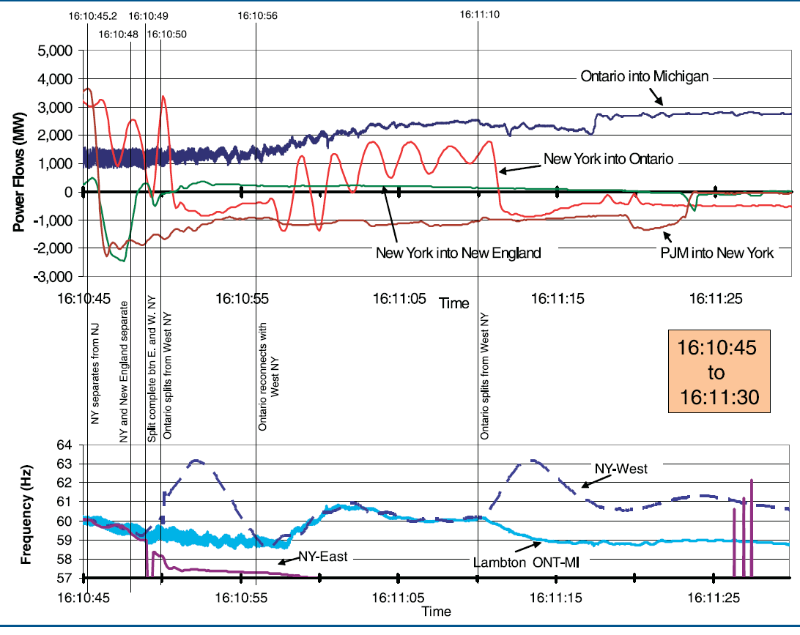
Dynamics Example 2: August 14 Blackout
Image from August 14, 2003 Blackout Final Report, energy.gov, Figure 6.26
8

Slide 10
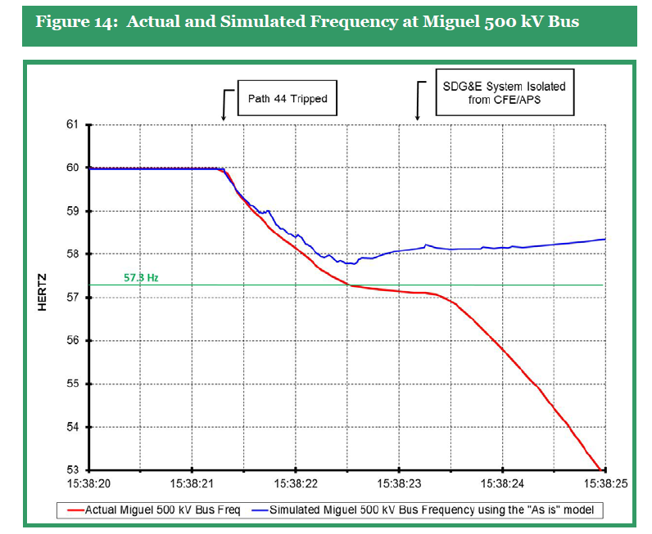
Dynamics Example 3: Arizona-Southern CA 2011
We’ve come a long ways since 1996 towards improved simulations. Still, a finding from the 2011 Blackout is the simulations didn’t match the actual system response and need to be improved.
Source: Arizona-Southern California Outages n September 8, 2011 Report, FERC and NERC, April 2012
9

Slide 11
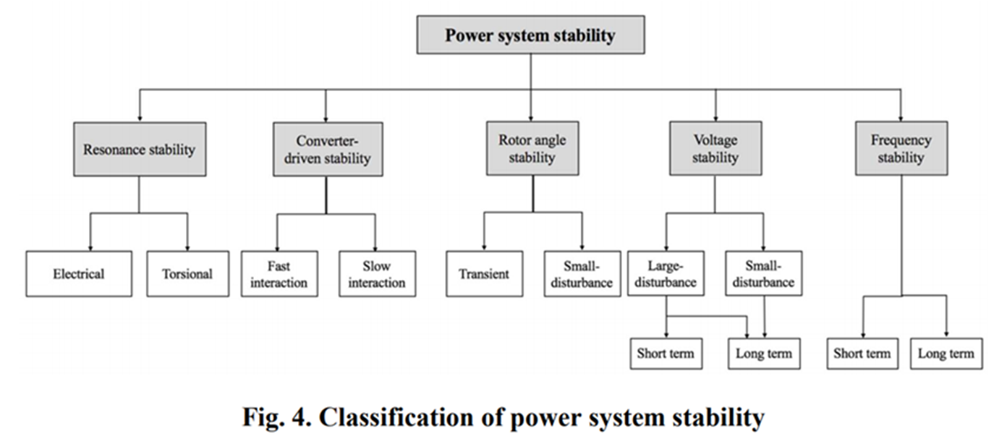
Power System Stability Terms
The terms continue to evolve, but a good reference is [a]; the image shows Figure 4 from this reference
[a] IEEE/PES Power System Dynamic Performance Committee, “Stability definitions and characterization of dynamic behavior in systems with high penetration of power electronic interfaced technologies”, PES-TR77, April 2020

Slide 12
An Example: Lightning Striking a Transmission Line
The sequence of events might be as follows
Lightning hits a transmission line, setting up an ionized path to ground
There are at least 30 million lightning strikes per year in the US; a typical stroke might have 25,000 amps with a rise time of 10 μs, dissipated in 200 μs; multiple strokes can occur in a single flash, causing the lightning appear to flick with a total event lasting a second
After the strike a conduction path is maintained by ionized air after the lightning strike has dissipated, resulting in high fault current (often > 25,000 amps); if this current is not removed it can cause high heating and mechanical stresses
Within one to three cycles (16-50 ms) relays at both ends of the line detect high currents, signaling circuit breakers to open the line
Nearby locations see decreased voltages
The circuit breakers open to de-energize the line in an additional one to two cycles
Circuit breakers may reclose after several seconds to restore service

Slide 13
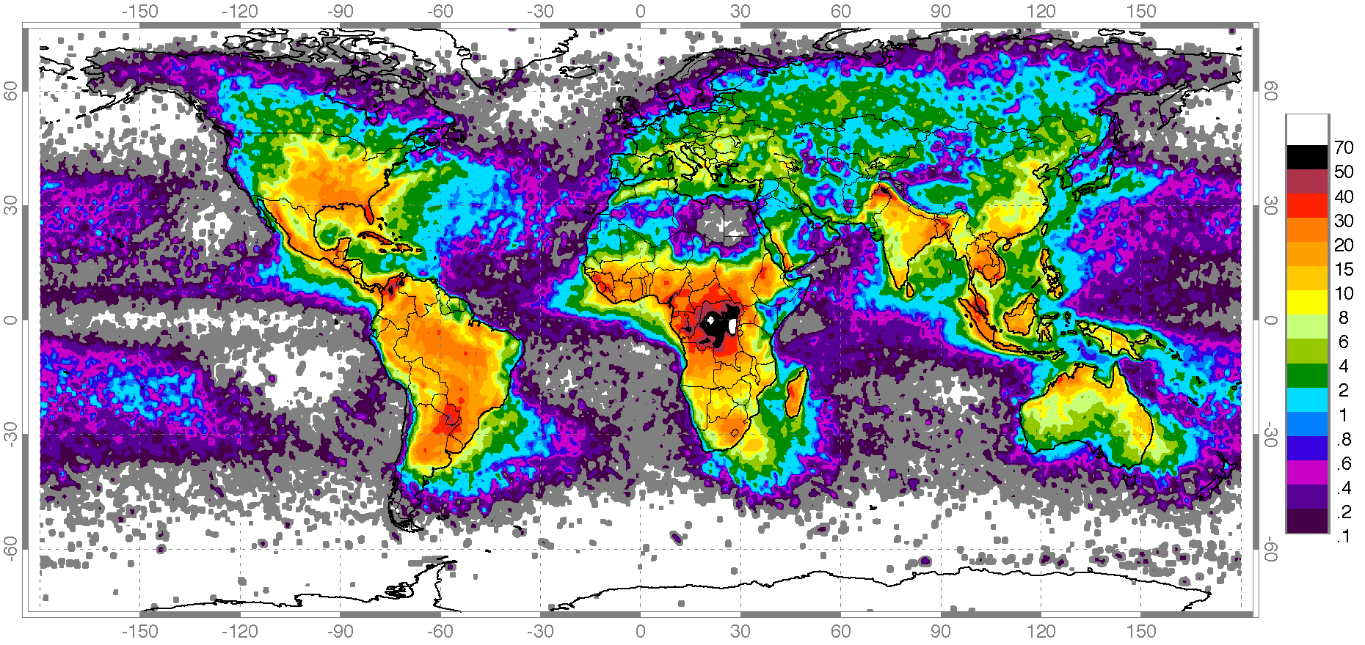
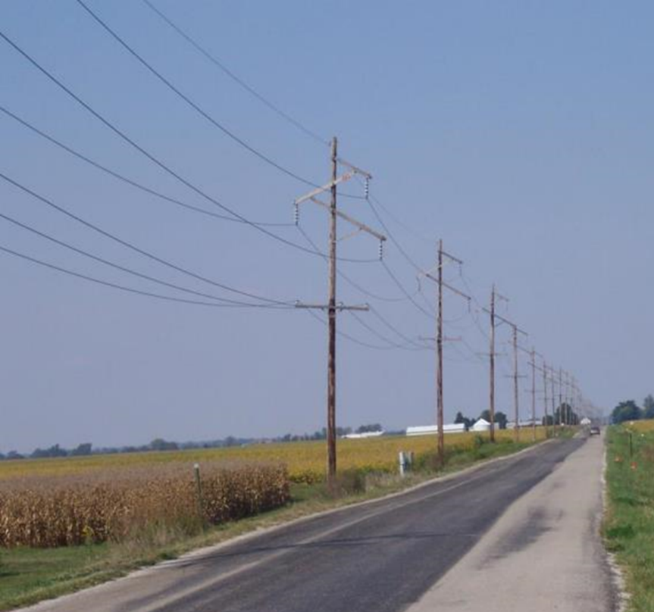
Worldwide Map of Lighting Strikes
Lightning is a major issue in many locations, but not everywhere; where lightning is common transmission lines have ground wires for lightning protection
Image source: en.wikipedia.org/wiki/Distribution_of_lightning

Slide 14
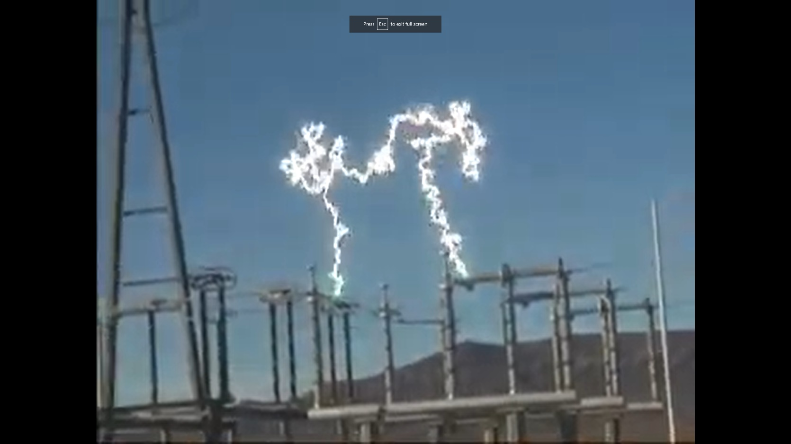
Example of Ionized Air
The video shows opening a 500 kV disconnect while there was still load current (disconnects are not designed to break load current); once ionized air becomes a good conductor

Slide 15
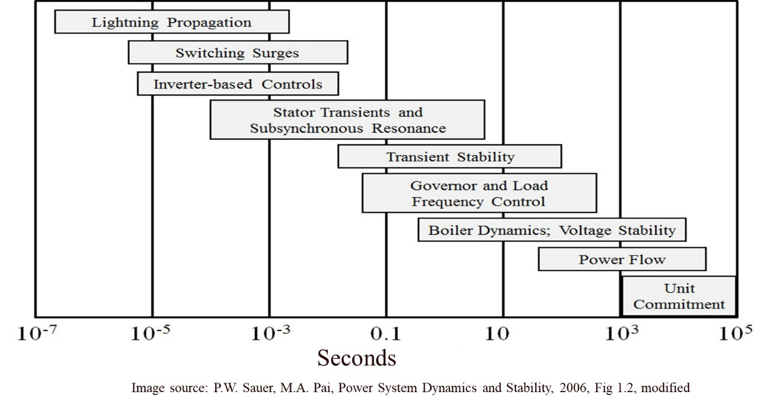
Two Different Types of Simulations for Lightning
Faults caused by lightning are simulated using two different approaches for two different purposes
Simulations using very fast time steps are done for insulation coordination studies; the goal is to design the grid so it can withstand the initial lightning strike; these simulations packages are known electromagnetic transients program (EMTP)
They can use simulation time steps of less than 1 μs, and light only travels 300m in a microsecond
The small timesteps means either they solve relatively small systems or use lots of computer hardware to do the simulations

Slide 16
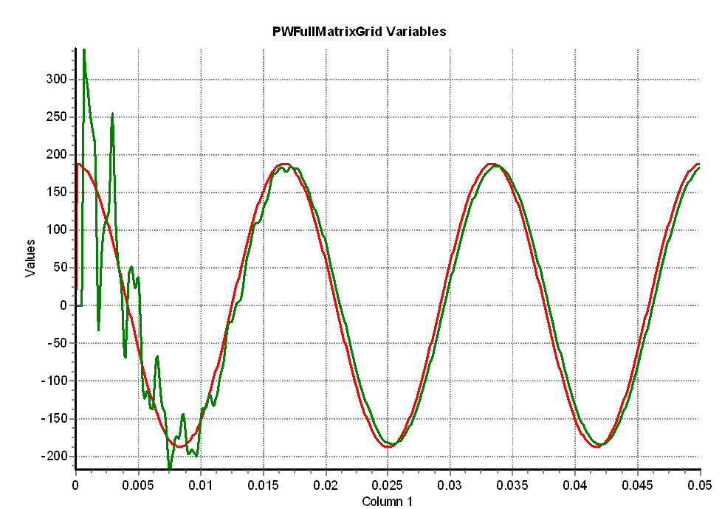
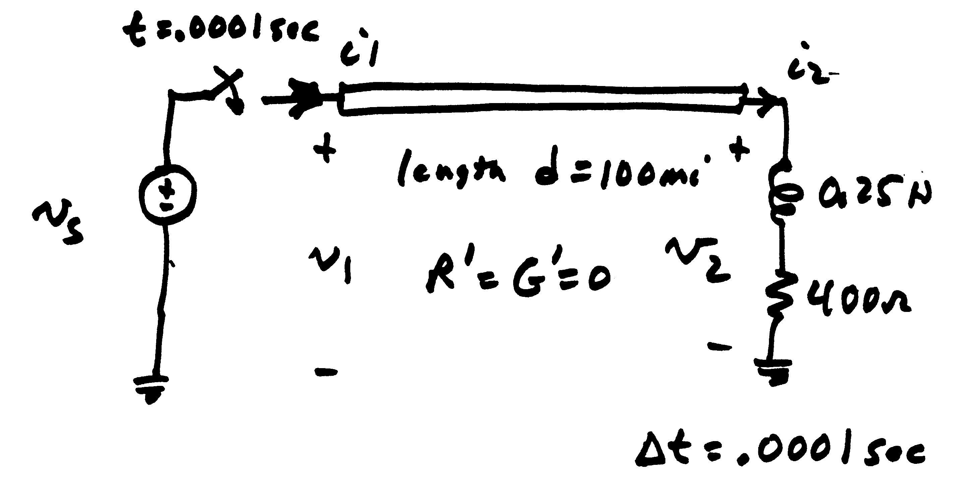
An Example of a Switching Surge
On a very fast time-scale, when a transmission line is closed there is a traveling voltage wave that goes down the line, and reflects off the far end; this high frequency oscillations damp out quickly, but need to be considered in the protection system design
Voltage in kV
Time in seconds

Slide 17
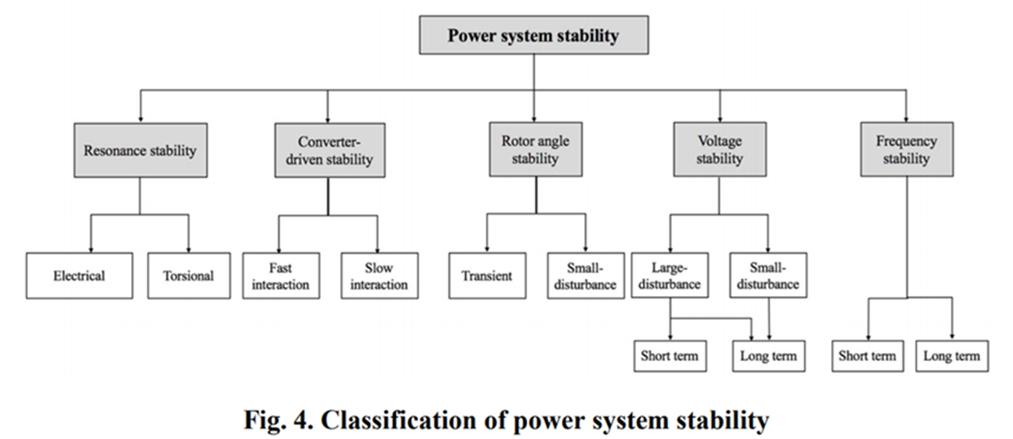
Stability Simulations
The second type of studies are known as stability simulations (or sometimes transient stability) with a focus on determining whether the system will stay together after the fault
A traditional focus has been on whether the generators will maintain synchronism
These studies typically use time steps on the order of about ¼ to ½ electrical cycle (so around 0.004 to 0.008 seconds)
The larger time step allows the study of large systems, often up to an entire interconnect

Slide 18
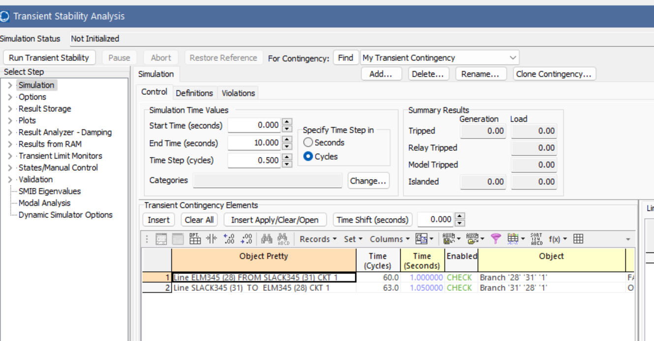
Doing a Stability Simulation
A good way to introduce stability studies is to do one in PowerWorld using a case that is very similar to the previous 37 bus case, augmented to include dynamic models (which we’ll get to in the next few slides)
Open the case B37_Stability, and select Add Ons, Transient Stability
This displays the Transient Stability Analysis Form, which is what we’ll use to do simulations
Key to a simulation is defining the sequence of events (contingency elements)

Slide 19
Doing a Stability Simulation
Doing a stability simulation also involves setting a number of other values, such as the start/end time, a time step size, and what to save. Assuming these are set (which they are here), then doing the simulation just involves pressing the Run Transient Stability button
There are many options for showing the results

Slide 20
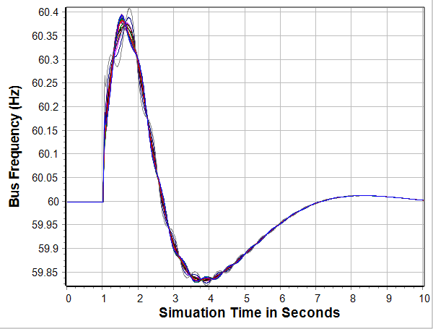
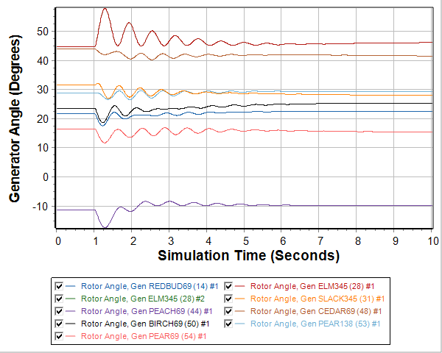
Looking at the Stability Results
A common way to look at the results is using plots of the time-variation of values, with the below graphs showing two examples
A detailed consideration of the plots is beyond the scope of this class, but these plots do show normal (desired) behavior

Slide 21
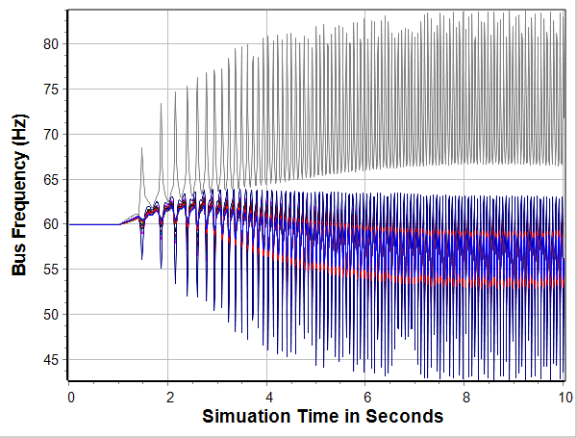
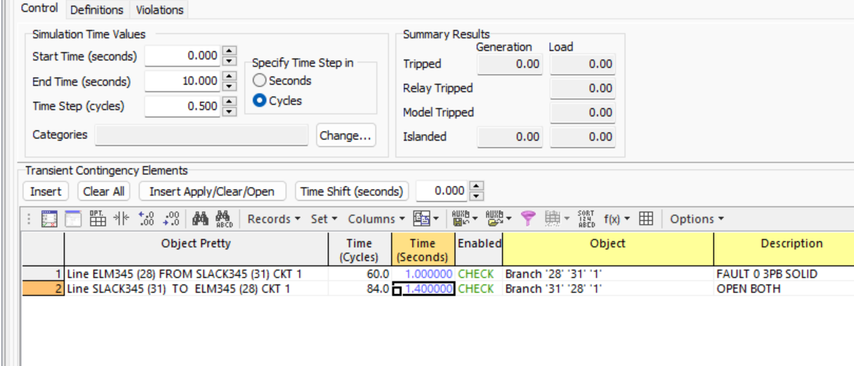
An Unstable Case Example
Change the fault clearing from being at time 1.05 seconds (0.05 seconds after the fault) to being at 1.4 seconds; then re-run; this gives an unstable result

Slide 22
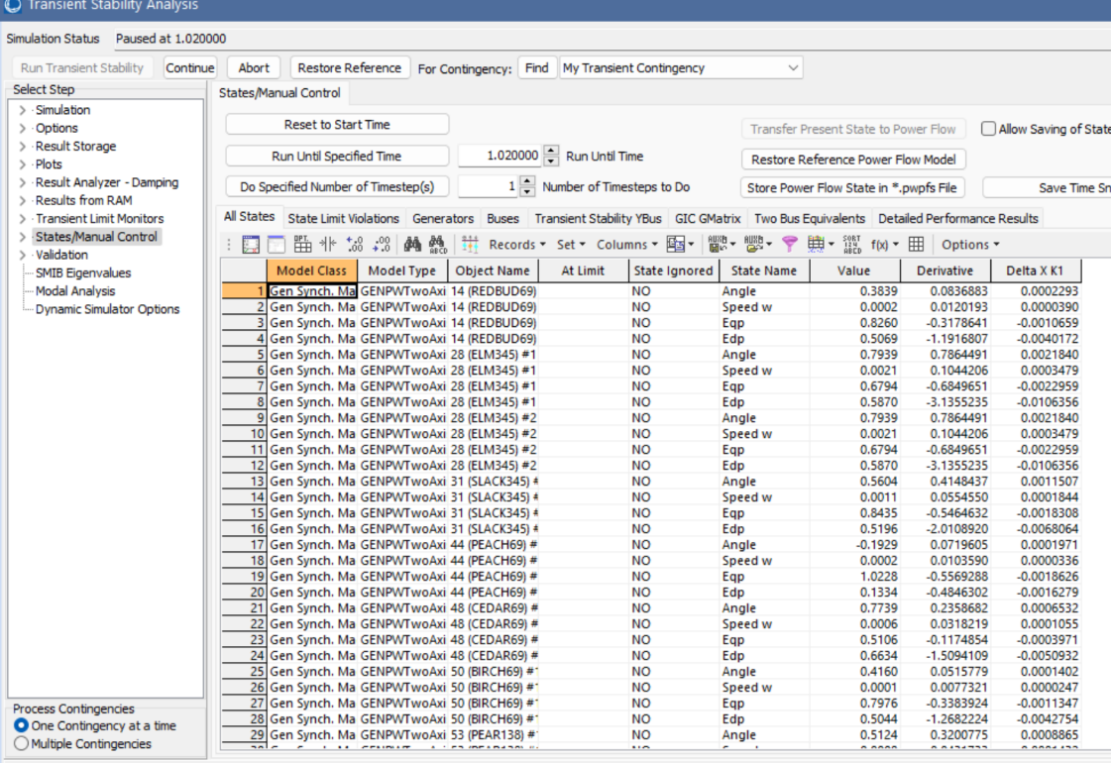
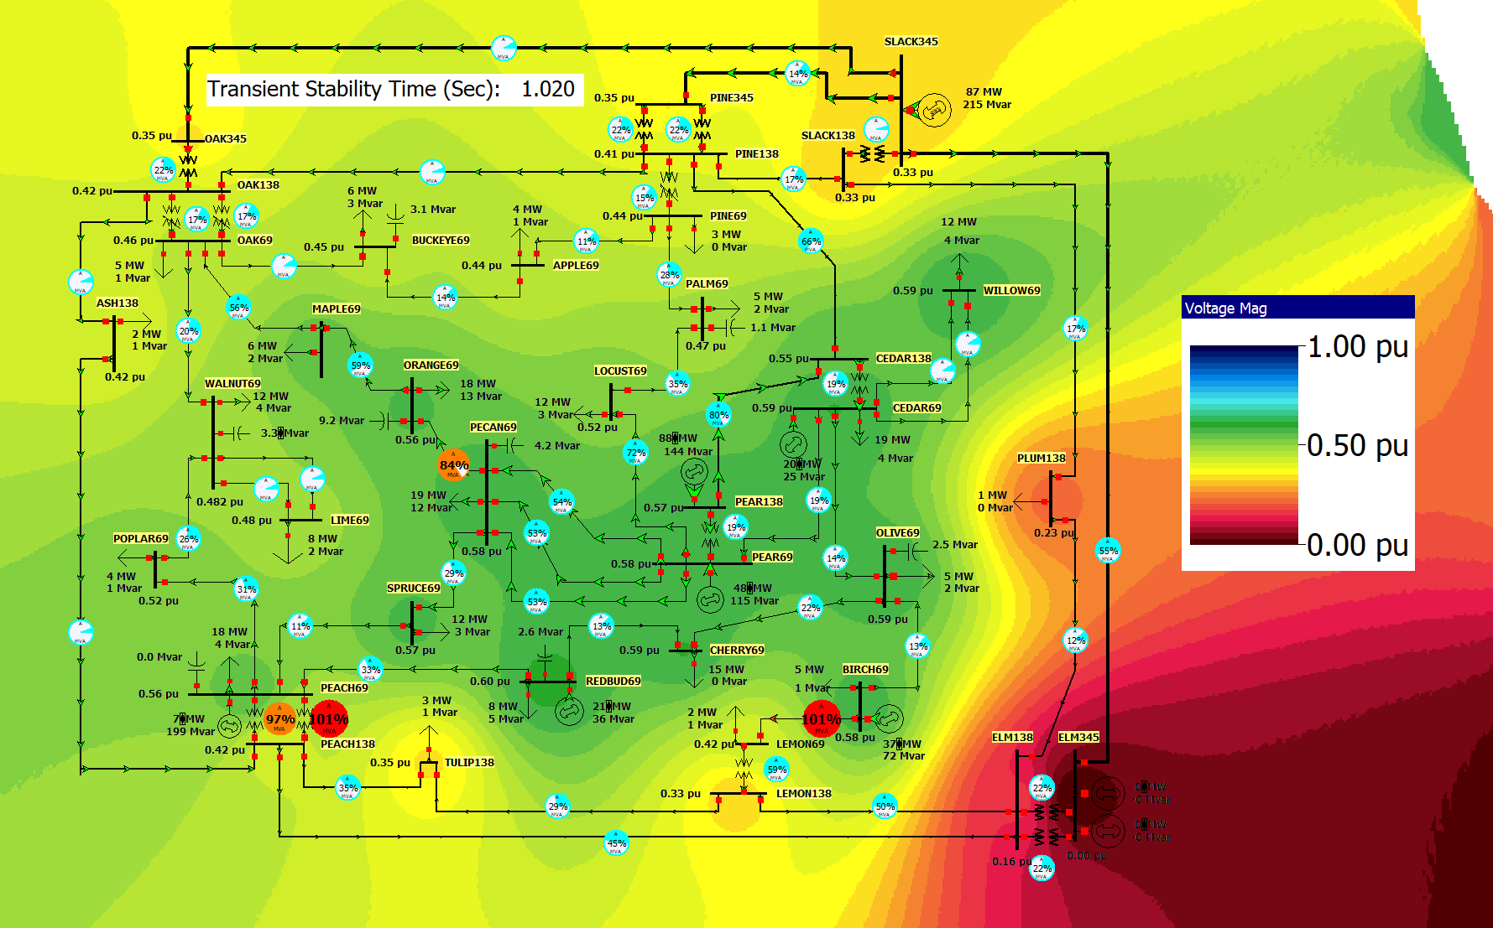
Visualizing Individual Time Points
Do see the simulation results at a particular on the Transient Stability Form select States/Manual Control set the Run Until Specified Time to 1.02 seconds and click on the Run Until Specified Time button
The contour shows very low voltages across much of the system; this is why lights “blink” during a fault

Slide 23
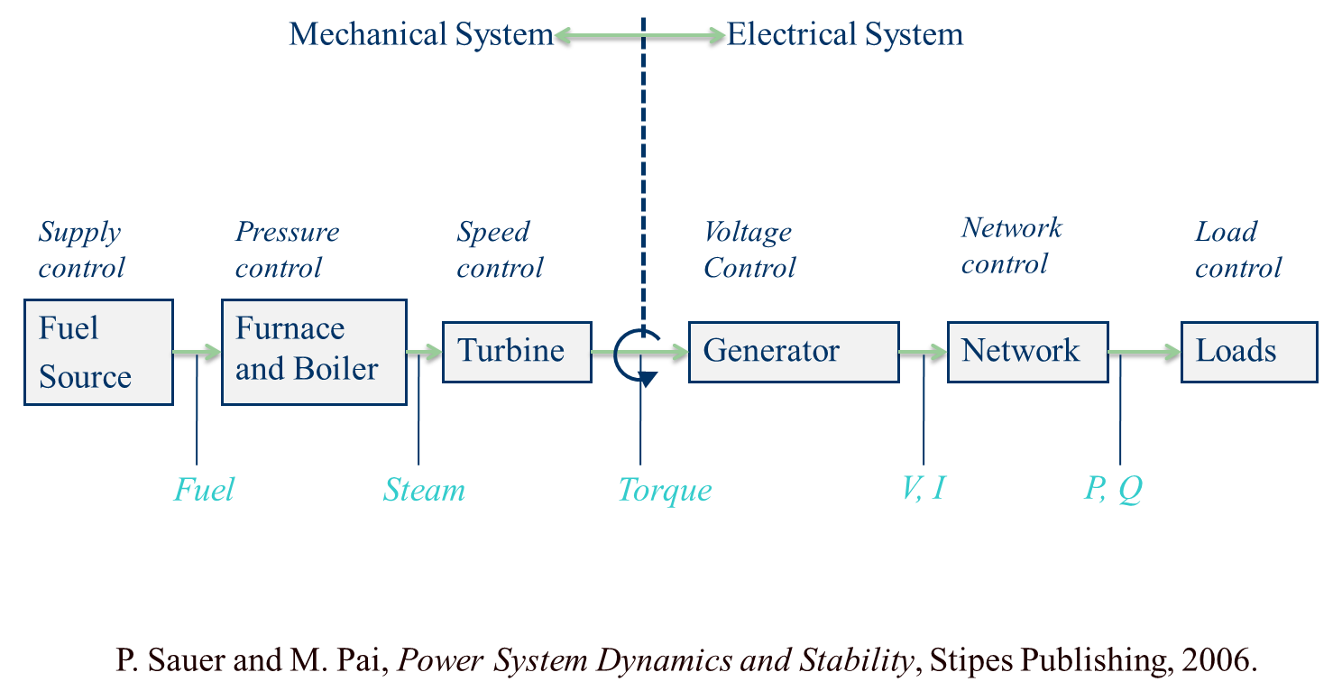
Physical Structure Power System Components
Doing these simulations requires more detailed models than for the power flow; below are of the devices that need models for a synchronous generator

Slide 24
Dynamic Models in the Physical Structure
Mechanical System
Electrical System
Stabilizer
Load
Relay
Line
Relay
Exciter
Supply control
Pressure control
Speed control
Voltage Control
Network control
Load control
Fuel
Source
Furnace and Boiler
Turbine
Generator
Network
Loads
Machine
Load
Char.
Fuel
Steam
Torque
V, I
P, Q
Governor
P. Sauer and M. Pai, Power System Dynamics and Stability, Stipes Publishing, 2006.

Slide 25
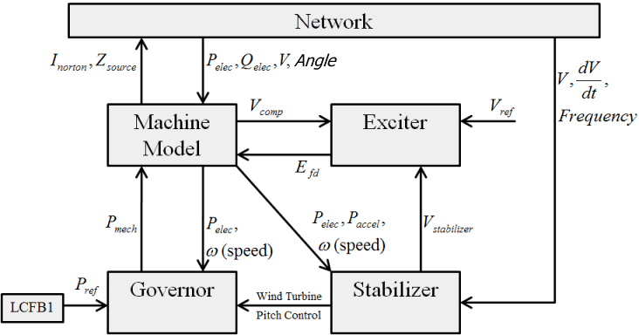
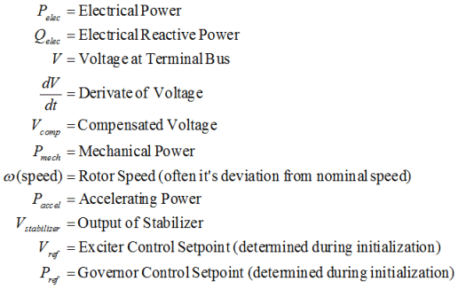
Synchronous Generator Models

Slide 26
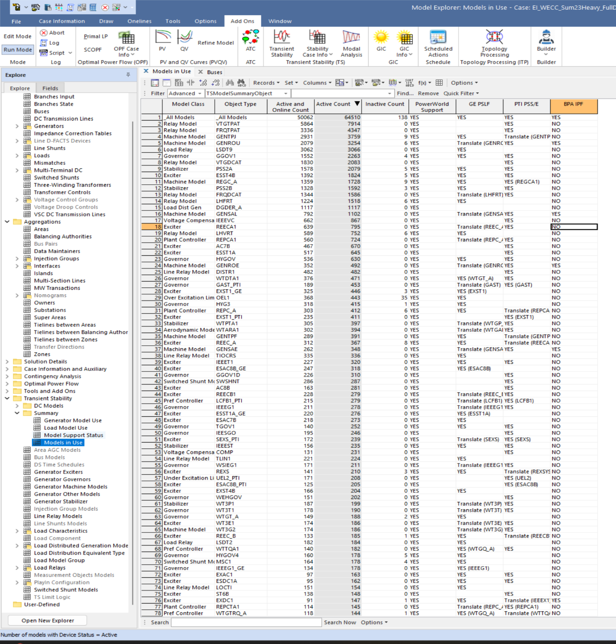
There can be Hundreds of Different Types of Models
In a project we are doing looking at connecting the North American Eastern and Western grids we have a case with 120,000 buses, and 248 different types of dynamic models, and a total of 64,500 different dynamic model instances
Each instance can have many different parameters

Slide 27
Infinite Bus Modeling
An infinite bus is assumed to have a fixed voltage magnitude and angle; hence its frequency is also fixed at the nominal value.
Infinite buses obviously do not exist, but at least one (e.g., a slack bus) is needed in every power flow island
Infinite buses can be a useful concept when learning about transient stability and when “debugging models”
By default PowerWorld Simulator does NOT treat the slack bus as an infinite bus, but does provide an option.
Here we will use this option in creating a simple case by selecting Options and the Power System Model tab; set Infinite Bus Modeling to “Model the power flow slack bus(es) as infinite buses”

Slide 28
Quickly Setting Up a Dynamics Case
Open the case Example_13_4_NoModels; this is a four bus power flow case with no dynamic models
To add a model, right-click on the Bus 4 generator, select Generator Information Dialog; go to the Stability page; on the Machine Models tab click Insert and select GENCLS; click OK
This added a very simple dynamic model for the generator
Select Add Ons, Transient Stability; click Run Transient Stability
This does the simulation, but nothing occurs because no contingency events have been defined

Slide 29
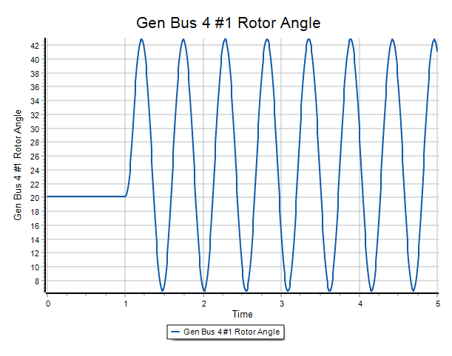
Quickly Setting Up a Dynamics Case, cont.
On the Transient Contingency Elements tab click Insert/Apply/Clear/Open to put in a fault that is subsequently cleared; pick Bus 3 rerun the simulation
Got to the Results from RAM page and view the generator results
To see a plot of the results, right-click on any result column, and select Plot Column
The result shows the generator oscillating as a result of the fault (the GENCLS model does not have implicit damping)
In PowerWorld there are many ways to further customize and expand the simulation

Slide 30
Frequency Response for Generation Loss
A common contingency is the response of the grid to the loss of a large generator
In response to a rapid loss of generation, in the initial seconds the system frequency will decrease as energy stored in the rotating masses is transformed into electric energy
Some generation, such as solar PV has no inertia, and for most new wind turbines the inertia is not seen by the system
Within seconds governors respond, increasing the power output of controllable generation
Many conventional units are operated so they only respond to over frequency situations
Solar PV and wind are usually operated in North America at maximum power so they have no reserves to contribute

Slide 31
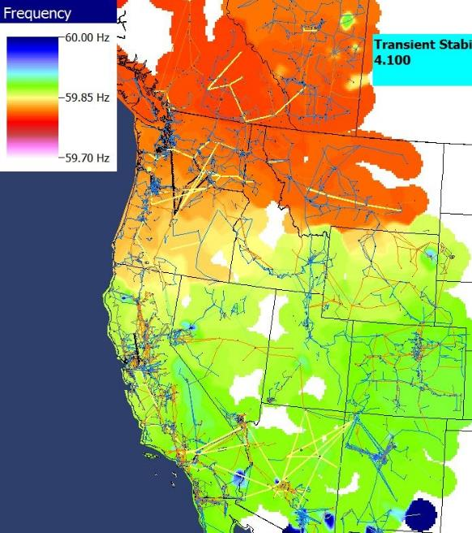
Short Term (20 Seconds) Example
Figures show the frequency change as a result of the sudden loss of a large amount of generation in the Southern WECC
Freq. Hz)
Frequency Contour
Time in Seconds

Slide 32
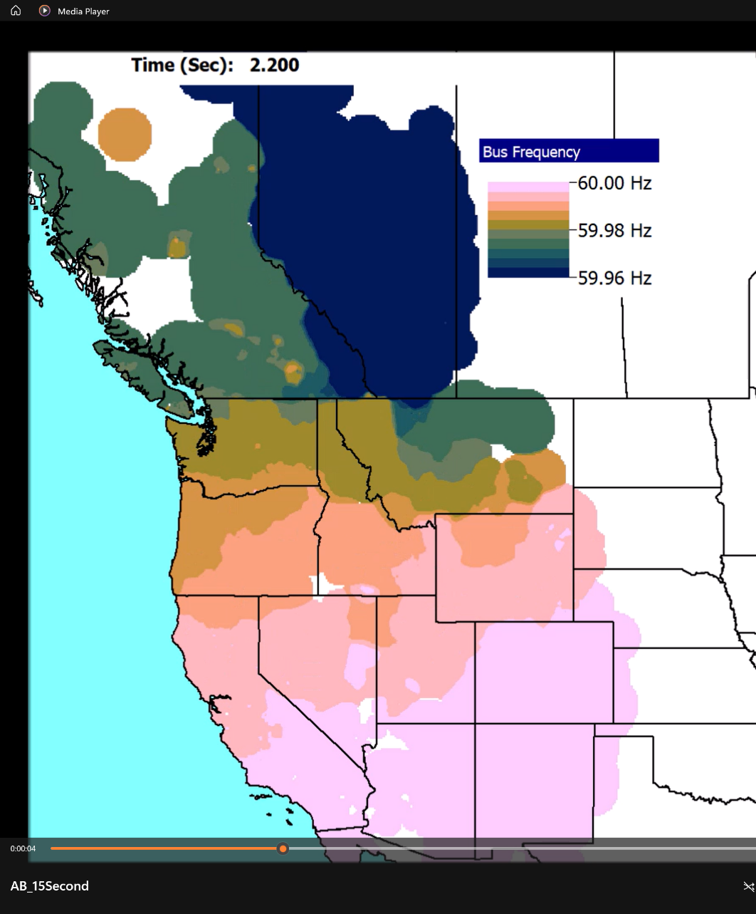
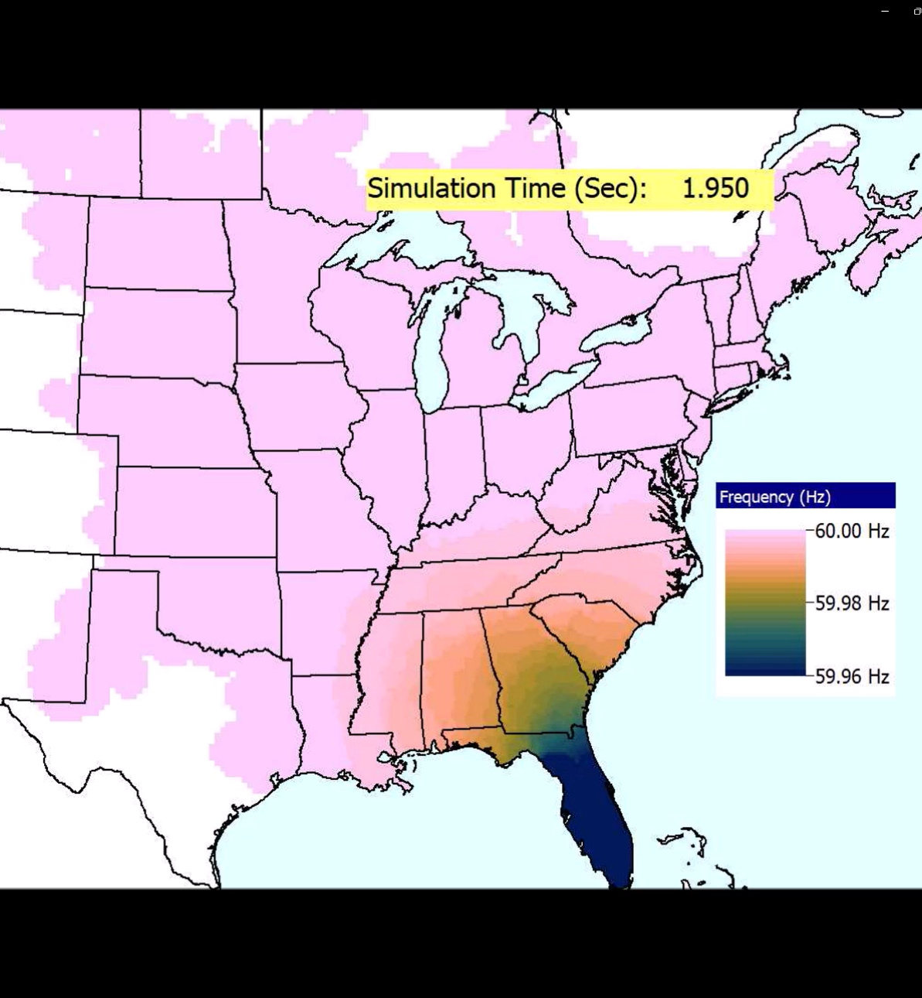
Frequency Contour Videos for the West and East
Video is FreqMovie_WECC
Video is FreqMovie_East

Slide 33
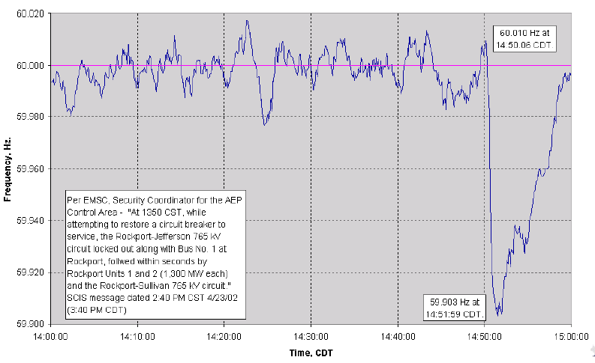
Longer Term Frequency Recovery
Normally the frequency recovers in about ten minutes

Slide 34
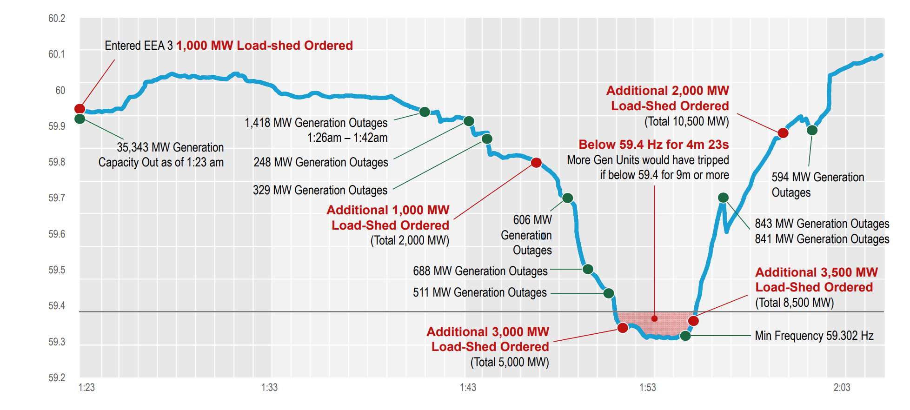
ERCOT Winter Storm Uri Frequency (2/15/21)
Image source: https://www.ercot.com/files/docs/2021/03/03/Texas_Legislature_Hearings_2-25-2021.pdf

Slide 35
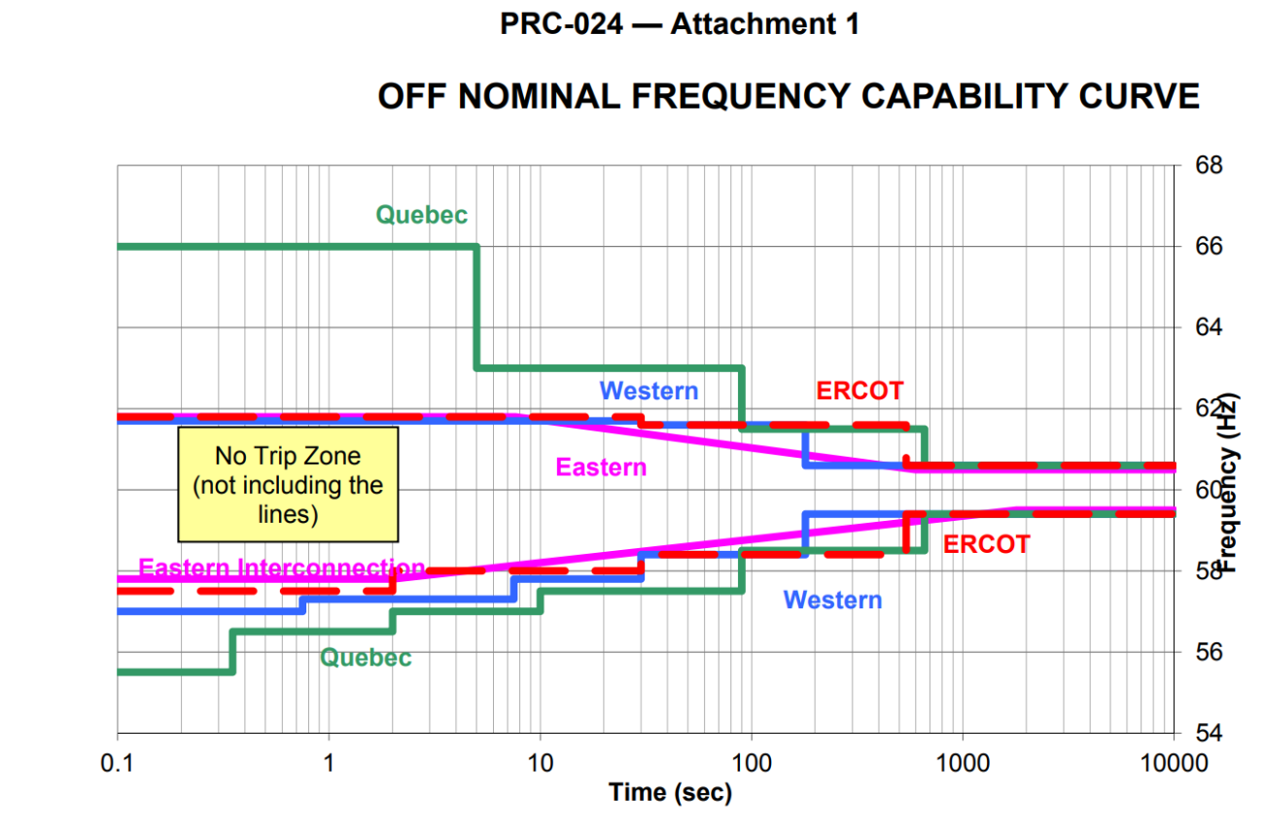
Generator Under and Over Frequency Protection
Generators have automatic protection systems to trip them if the frequency goes out of range for too long (also their voltage)
A typical concern with off-nominal frequency operation is the turbine (i.e., not the synchronous machine) operating at close to one of its natural frequencies, resulting in accelerated aging (metal fatigue); this is often shown using a Campbell diagram; see IEEE C37.106.2022
NERC Standard PRC-024.1

Slide 36
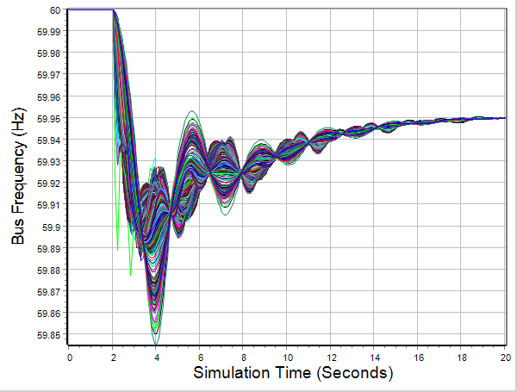
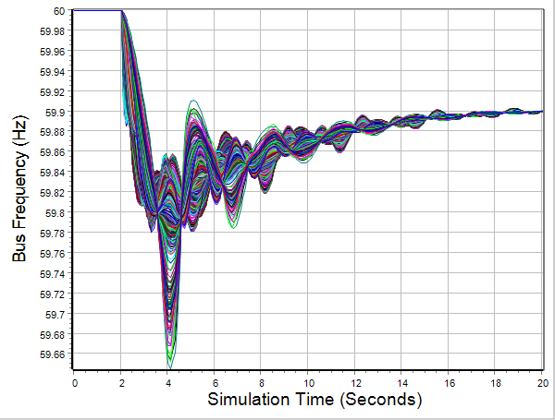
2000 Bus Generator Outage Example
To do an example larger case generator drop stability study, open the case Texas2000_GenDrop
Case has 67,000 MW of load; contingency is the loss of a 1350 MW generator
Go to the Transient Stability form and click Run Transient Stability
Rerun but drop two generators (one event is initially disabled)
1350 MW loss
2700 MW loss

Slide 37
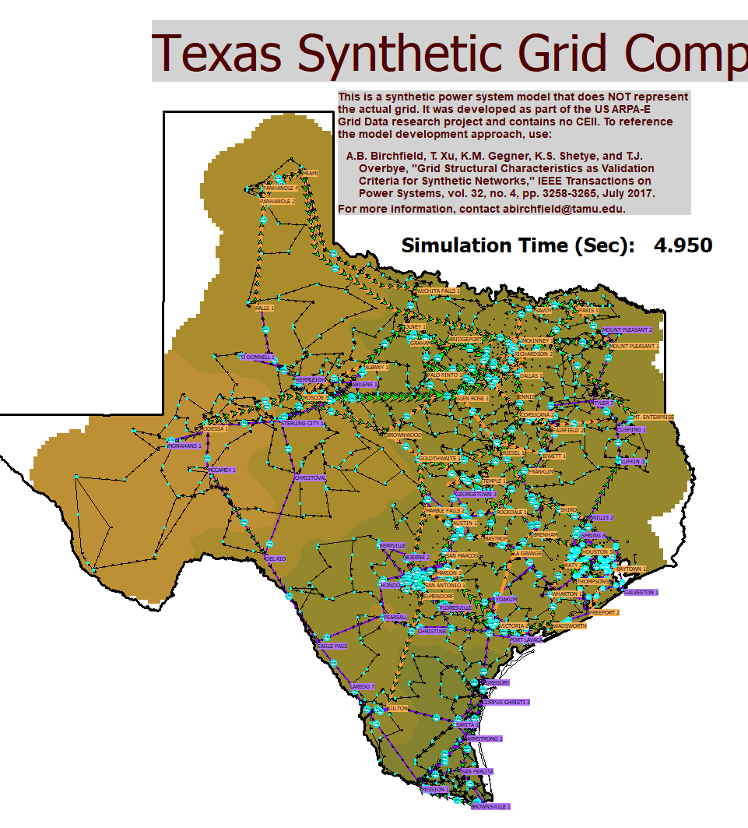
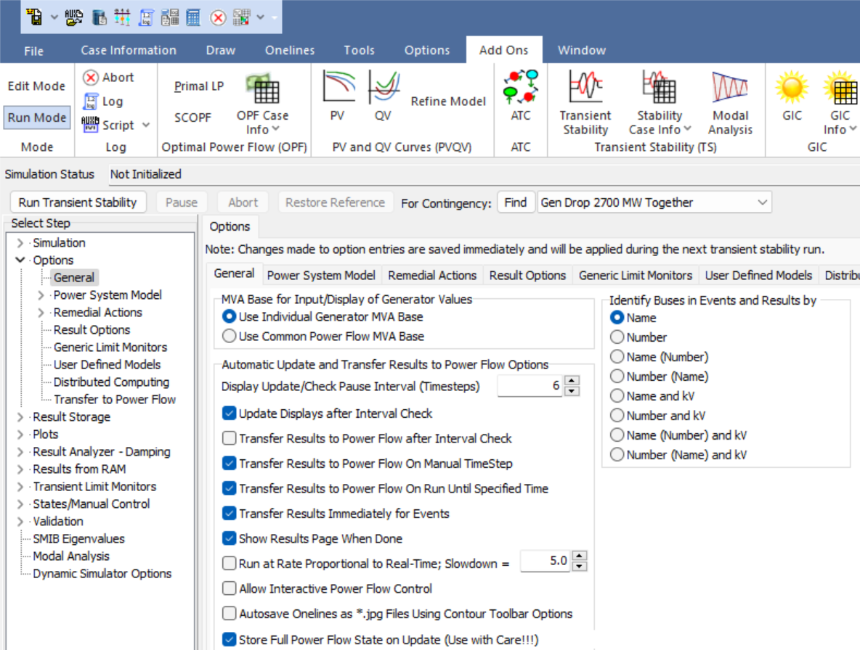
Showing an Animated Frequency Contour
To see an animated frequency contour, on the Options, General page check the Transfer Results to Power Flow After Interval Check field

Slide 38
Load Modeling
The assumed model for the load can have a significant impact on simulation results, particularly the voltage response
Constant power loads are, in general, not a good choice
Traditionally load models have been divided into two groups
Static: load is a algebraic function of bus voltage and sometimes frequency
Dynamic: load is represented with a dynamic model, with induction motor models the most common
The simplest load model is a static constant impedance
Has been widely used
Allowed the Y_{bus} to be reduced, eliminating essentially all non-generator buses
Presents no issues as voltage falls to zero
No longer commonly used

Slide 39
Load Modeling References
Many papers and reports are available!
A classic reference on load modeling is by the IEEE Task Force on Load Representation for Dynamic Performance, "Load Representation for Dynamic Performance Analysis," IEEE Trans. on Power Systems, May 1993, pp. 472-48
NERC 2016, “Dynamic Load Modeling”; available at https://www.nerc.com/comm/PC/LoadModelingTaskForceDL/Dynamic%20Load%20Modeling%20Tech%20Ref%202016-11-14%20-%20FINAL.PDF
NERC Reliability Guideline, “Developing Load Model Composition Data, 2017”
EPRI Technical Guide to Composite Load Modeling, Sept. 2020
https://www.epri.com/research/programs/027570/results/3002019209

Slide 40
ZIP Load Model (Static, can be used in Power Flow)
The most common static load model is the ZIP, in which the load is represented as
Some models allow more general voltage dependence
Constant impedance is a special case of this model
The voltage exponent for reactive power is often > 2

Slide 41
Discharge Lighting Models
Discharge lighting (sending electricity through a gas such as fluorescent lamps) have been at major portion of the load (10-15%) though now it is getting increasingly replaced by LEDs
Discharge lighting has been modeled for sufficiently high voltage with a real power as constant current and reactive power with a high voltage dependence
Linear reduction for voltage between 0.65 and 0.75 pu
Extinguished (i.e., no load) for voltages below
May need to change with newer electronic ballasts – e.g., reactive power increasing as the voltage drops!

Slide 42
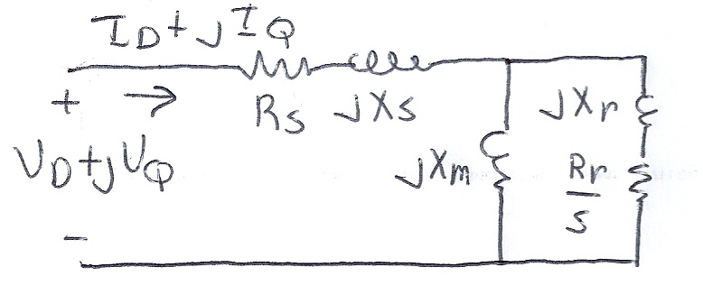
Dynamic Load Models
Most stability models now include a combination of static models with dynamic models
The major dynamic component of the load has been induction motors
Induction motors operate close to synchronous speed, but not a synchronous speed; a key value is their slip, s; the slip then is a parameter in their circuit model

Slide 43
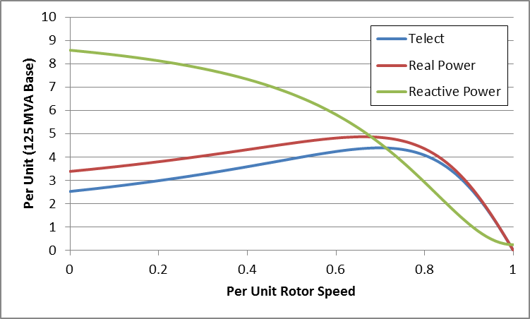
Induction Model Torque-Speed Curves
The below graph shows the torque-speed curve for this induction machine; note the high reactive power consumption on starting (which is why the lights may dim when starting a cloth dryer!)
From the graph you can see with a 100 MW load (0.8 pu on the 125 MW base), the slip is about 0.025

Slide 44
Induction Motor Stalling
Height of the torque-speed curve varies with the square of the terminal voltage
When the terminal voltage decreases, such as during a fault, the mechanical torque can exceed the electrical torque
This causes the motor to decelerate, perhaps quite quickly, with the rate proportional to its inertia
This deceleration causing the slip to increase, perhaps causing the motor to stall with s=1, resulting in a high reactive current draw
Too many stalled motors can prevent the voltage from recovering

Slide 45
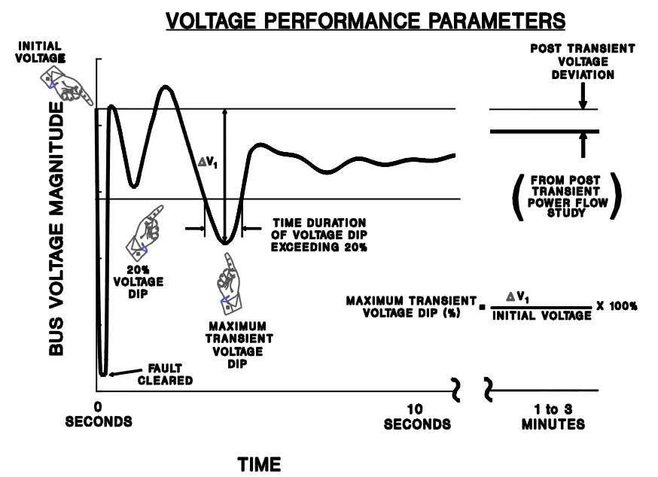
Transient Limit Monitors
During a transient contingency how fast the voltage recovers is a key metric
Similar performance criteria exist for frequency deviations
Image from WECC Planning and Operating Criteria

Slide 46
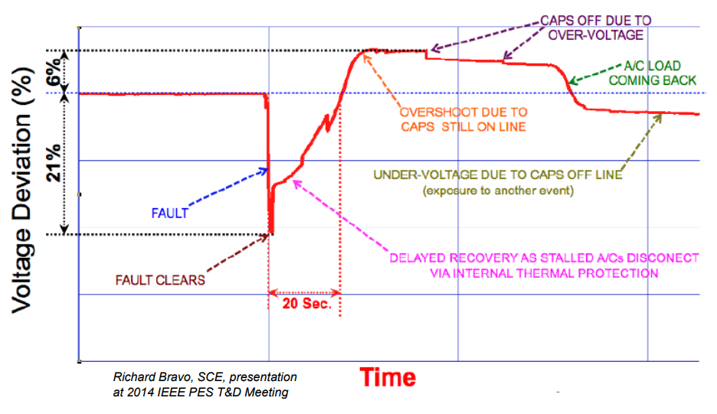
A Concern: Fault Induced Delayed Voltage Recovery (FIDVR)
FIDVR is a situation in which the system voltage remains significantly reduced for at least several seconds following a fault (at either the transmission or distribution level)
It is most concerning in the high voltage grid, but found to be unexpectedly prevalent in the distribution system
Stalled residential air conditioning units are a key cause of FIDVR – they can stall within the three cycles needed to clear a fault
Image Source: NERC, Fault Induced Delayed Voltage Recovery (FIDVR) Advisory, July 2015

Slide 47
Composite Load Models
Many aggregate loads are best represented by a combination of different types of load
Known as composite load models
Important to keep in mind that the actual load is continually changing, so any aggregate load is at best an approximation
Hard to know load behavior to extreme disturbances without actually faulting the load
Early models included a number of loads at the transmission level buses (with the step-down transformer), with later models including a simple distribution system model

Slide 48
CLOD Model
The CLOD model represents the load as a combination of large induction motors, small induction motors, constant power, discharge lighting, and other

Slide 49
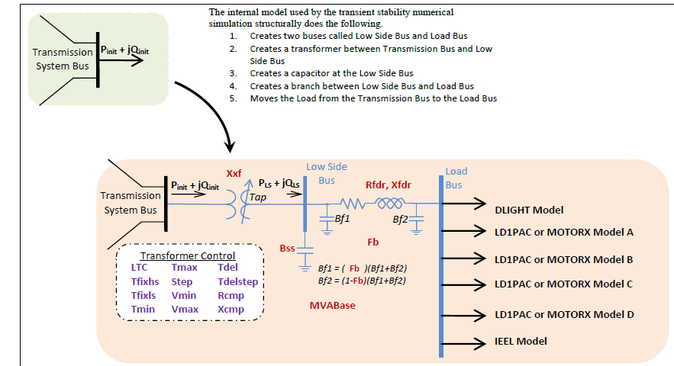
Composite Load Model
Contains up to four motors or single phase induction motor models; also includes potential for solar PV

Slide 50
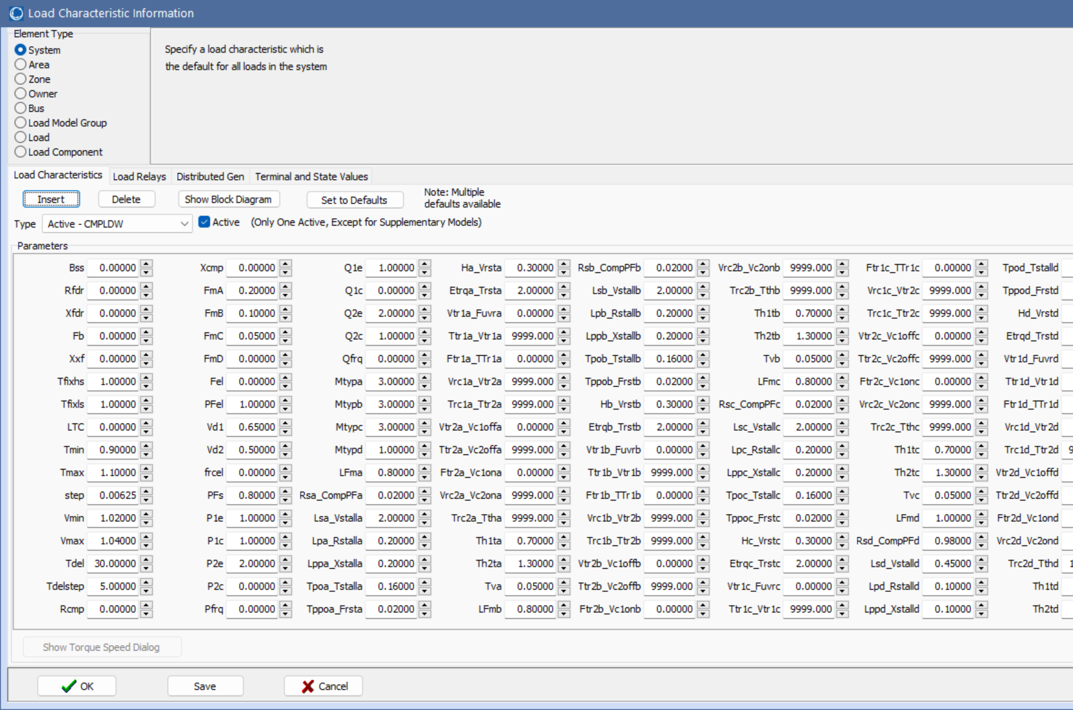
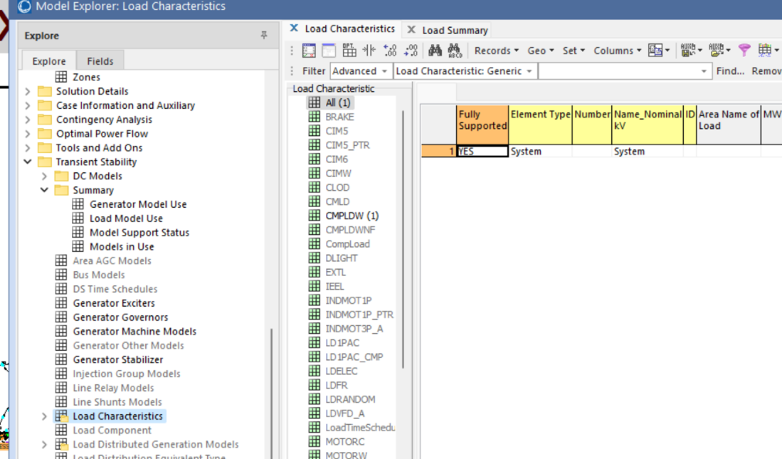
Running 2000 Bus Case with Composite Loads
Open the case Texas2000_CMPLDW; this is the previous 2000 bus case with the CMPLDW model applied to all loads
To see and modify the parameters in the Model Explorer select Transient Stability, Load Characteristics
Run the generator drop scenario varying these parameters; with this model the grid is no longer well damped (prone to oscillations)

Slide 51
Power System Oscillations
Power systems can experience a wide range of oscillations, ranging from highly damped and high frequency switching transients to sustained low frequency (< 1 Hz) inter-area oscillations affecting an entire interconnect
Types of oscillations include
Transients: Usually high frequency and highly damped
Local plant: Usually from 1 to 5 Hz
Inter-area oscillations: From 0.15 to 1 Hz
Slower dynamics: Such as AGC, less than 0.15 Hz
Subsynchronous resonance: 10 to 50 Hz (less than synchronous)

Slide 52
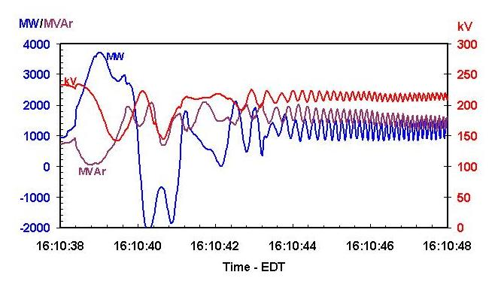
Example Oscillations
The left graph shows an oscillation that was observed during a 1996 WECC Blackout, the right from the 8/14/2003 blackout

Slide 53
Causes of Power System Oscillations
The response of a simple system can be divided into its natural response versus its forced response
The natural response tells how the system will response to an initial disturbance without any additional (external) influences; this response shows the system’s modes
A forced response is associated with an external disturbance; if the external disturbance is periodic then the system will oscillate at least partially at this frequency
Often forced oscillations are due to control failures
Resonance occurs when a forced response is at a similar frequency to one of the system’s modes
An power system can experience both types of oscillations

Slide 54
Forced Oscillations in WECC (from [1])
Summer 2013 24 hour data: 0.37 Hz oscillations observed for several hours. Confirmed to be forced oscillations at a hydro plant from vortex effect.
2014 data: Another 0.5 Hz oscillation also observed. Source points to hydro unit as well. And 0.7 Hz. And 1.12 Hz. And 2 Hz.
Resonance possible when system modes are poorly damped and close to the forcing function. Resonance can be observed in model simulations.
1. M. Venkatasubramanian, “Oscillation Monitoring System”, June 2015 http://www.energy.gov/sites/prod/files/2015/07/f24/3.%20Mani%20Oscillation%20Monitoring.pdf

Slide 55
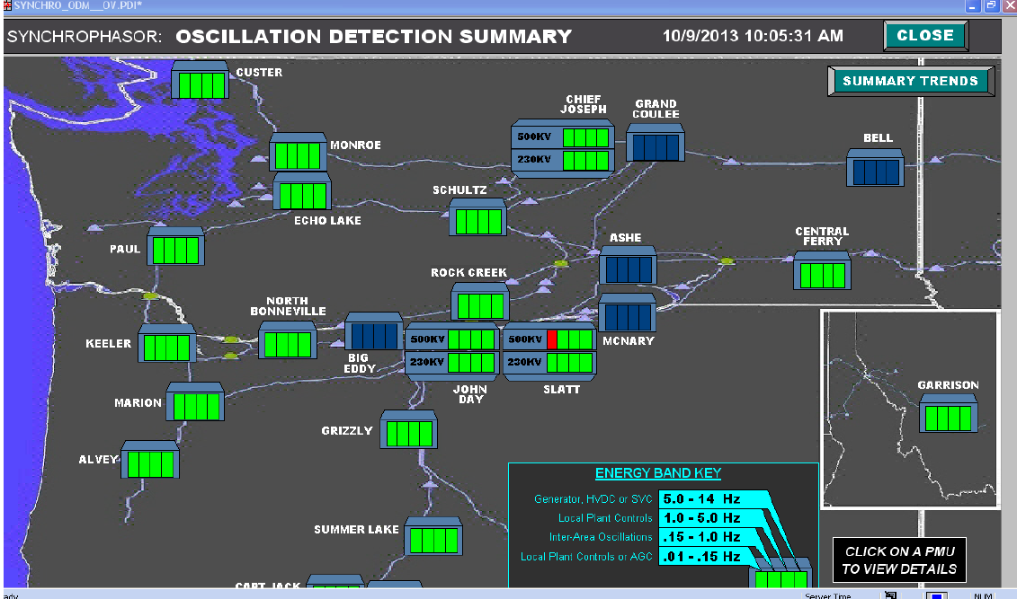
An On-line Oscillation Detection Tool
Image source: WECC Joint Synchronized Information Subcommittee Report, October 2013

Slide 56
Phasor Measurement Units (PMUs) and SynchroPhasors
Initially a challenge with understanding power system dynamics was the lack of high speed, synchronized measurements
Supervisory Control and Data Acquisition (SCADA) measured the system analog values every couple of seconds
This has gradually changed over the last several decades with the now widespread deployment of phasor measurement units (PMUs) that are able to use time synchronized measurements to accurately determine values at rates of 30 times per second

Slide 57
Modes
A mode is a concept from linear system analysis
Electric grids certainly are not linear, but usually their response to small disturbances is approximated as linear
A mode corresponds to one of the eigenvalues of the response or, for oscillations, a complex pair of eigenvalues
A mode has a frequency and damping; all parts of the system oscillate with this pattern
The mode shape tells how parts of the system participate in the mode
There can be multiple modes in a system; power systems can have many modes

Slide 58
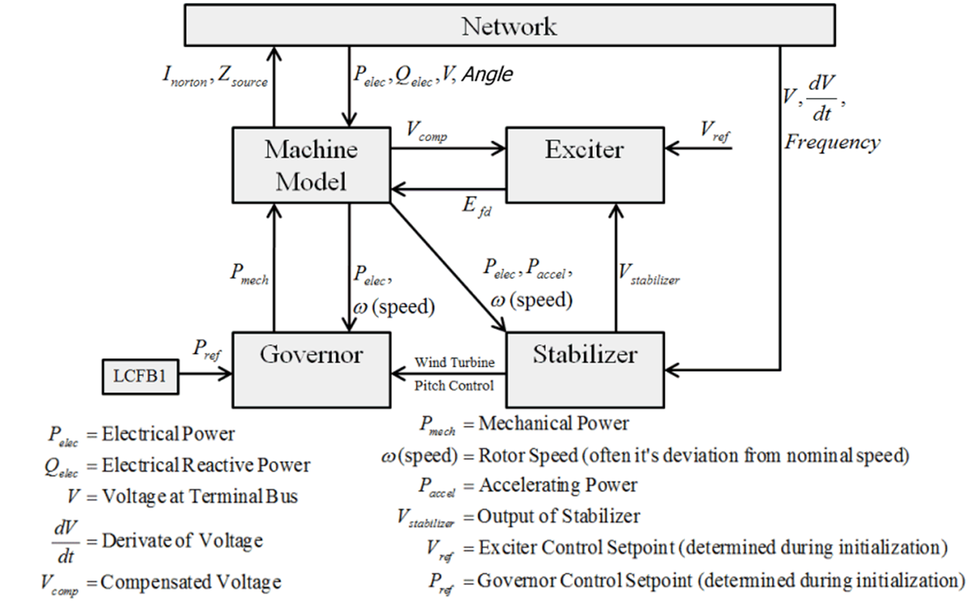
Power System Stabilizers (PSSs)
Power system stabilizers (PSSs) are devices that are placed at the generators to help stabilize the overall system response
They have played major role in damping both local modes and inter-area modes
However, the regular tuning of PSSs is important

Slide 59
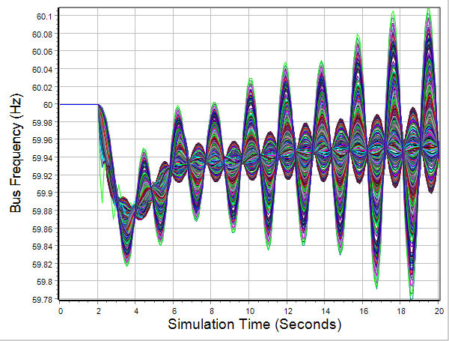
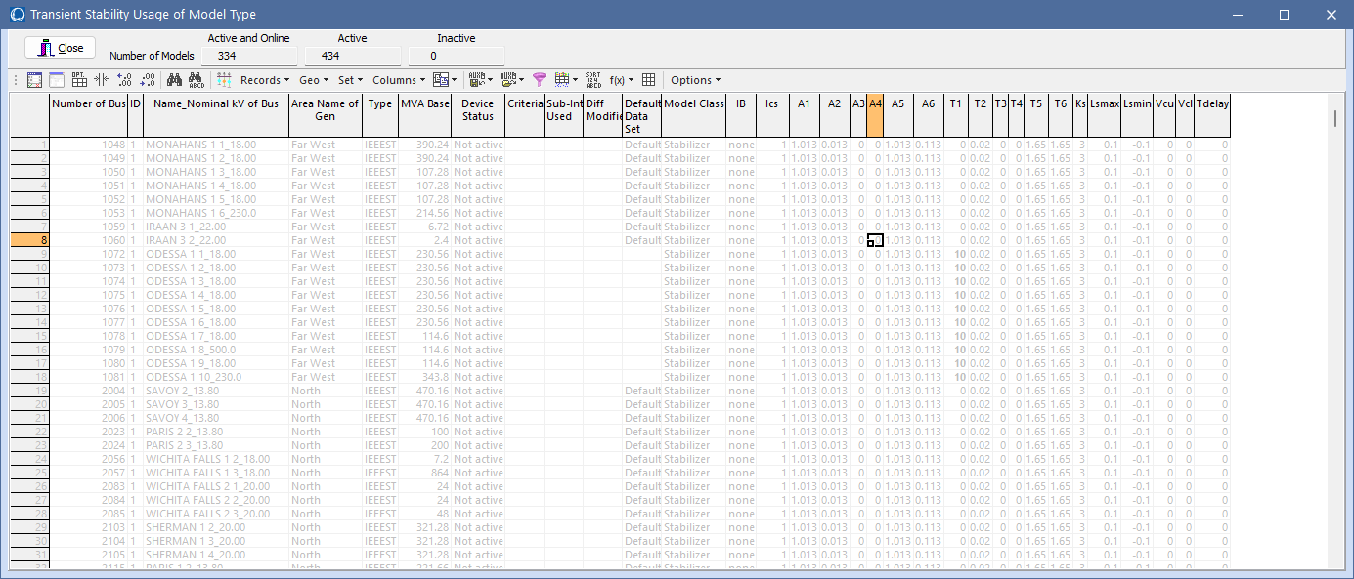
2000 Bus Generator Outage Example without PSSs
The previous 2000 bus case has PSSs; in PowerWorld their parameters can be easily viewed they can be displayed by starting from the Add Ons Stability Case Info, Models in Use display, then showing the Model Type Dialog for the IEEEST Stabilizer
Toggle Device Status to Not Active
Negatively damp oscillations

Slide 60
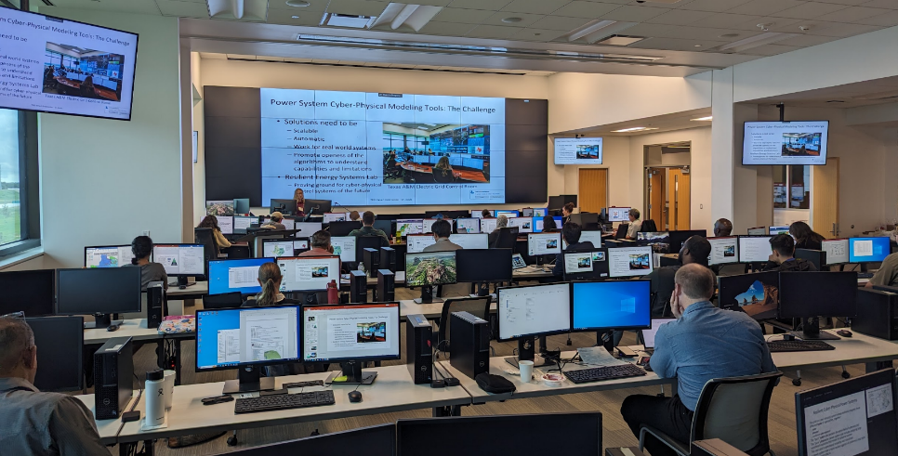
Questions?

